Slide 1
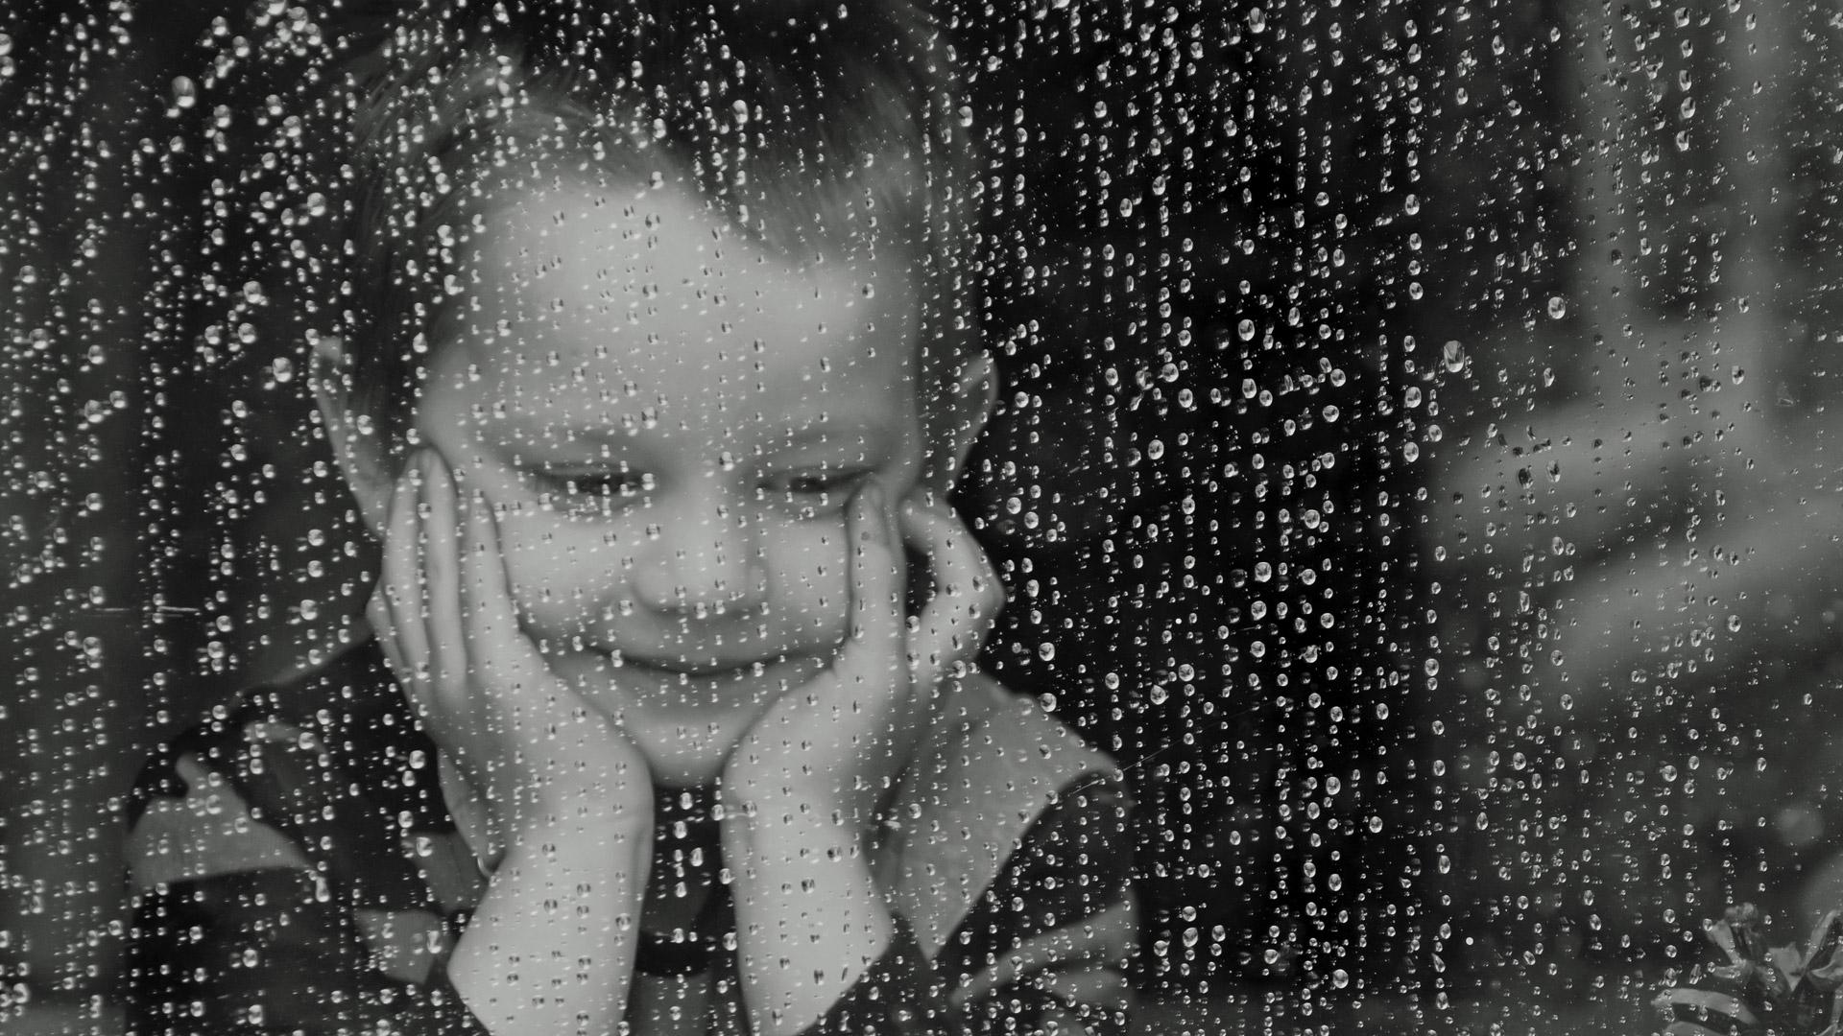

Slide 2
rain

Slide 3
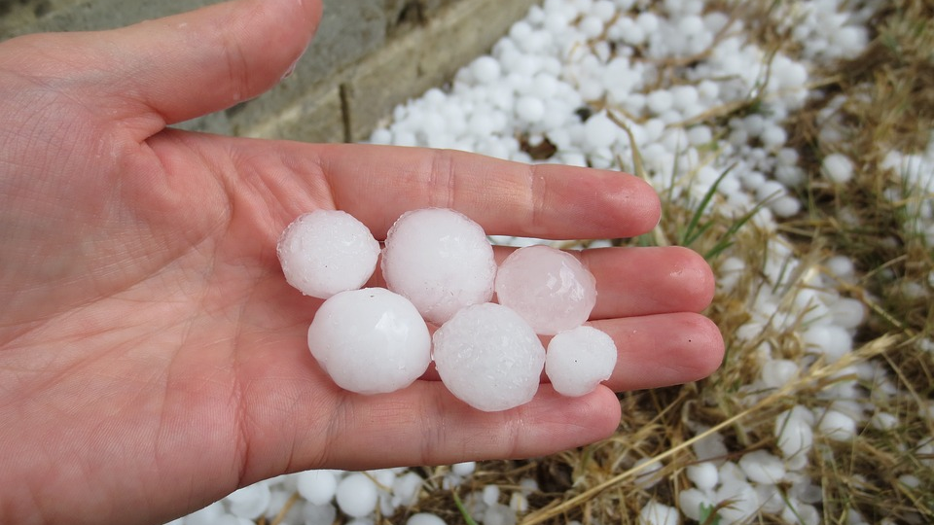

Slide 4
hail

Slide 5
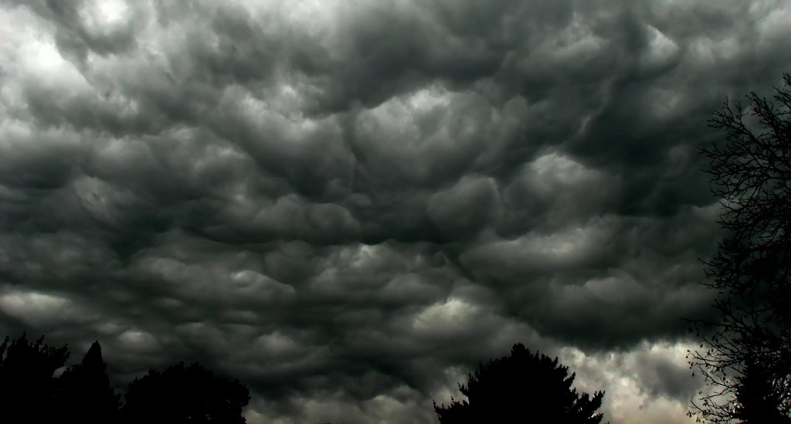

Slide 6
storm

Slide 7
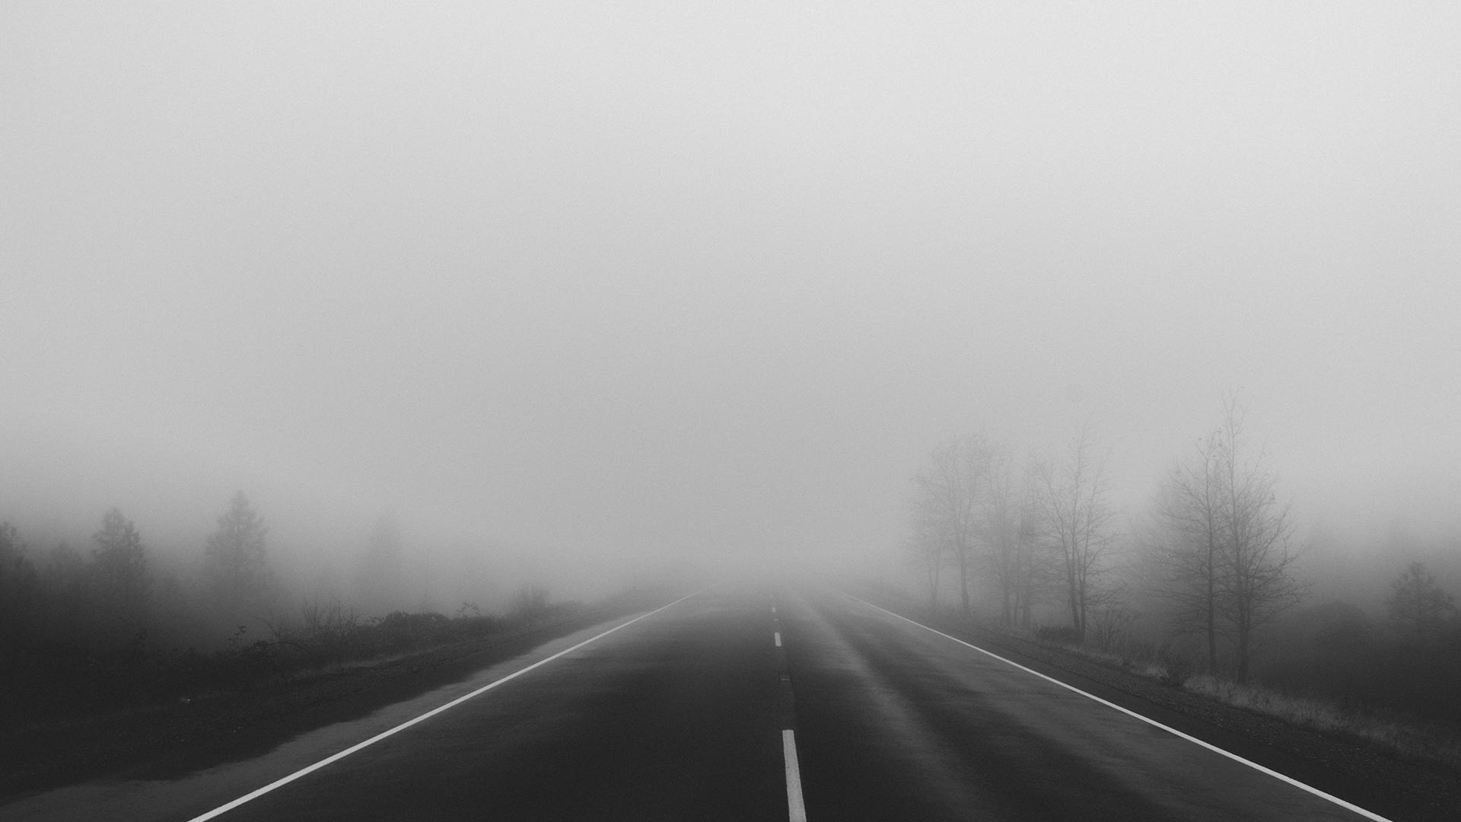

Slide 8
fog

Slide 9
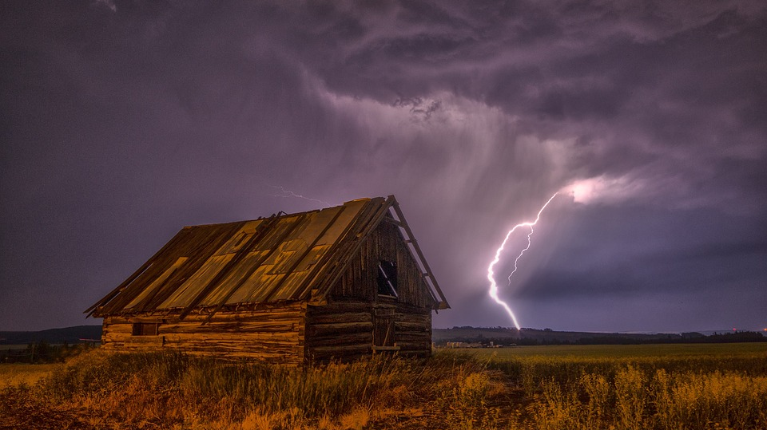

Slide 10
lightning

Slide 11
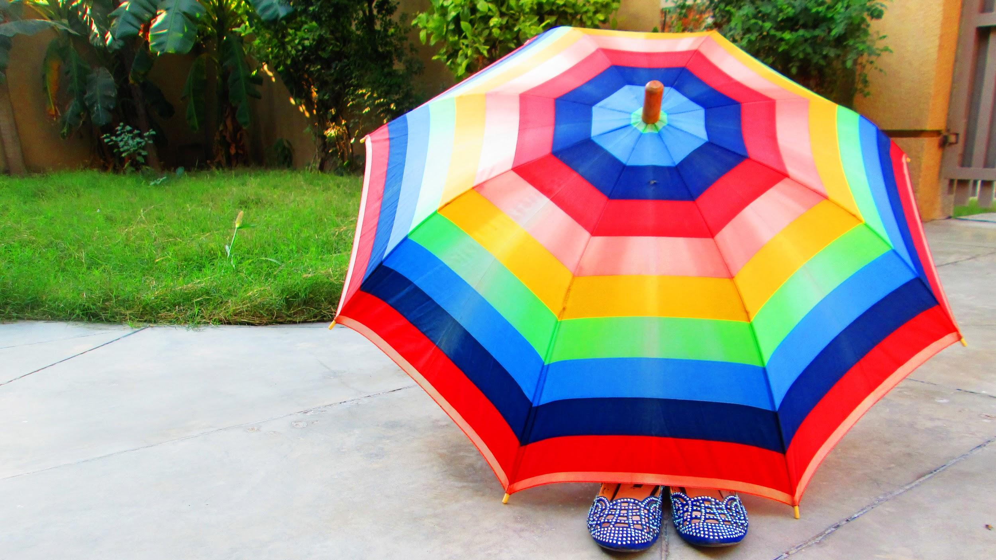

Slide 12
umbrella

Slide 13
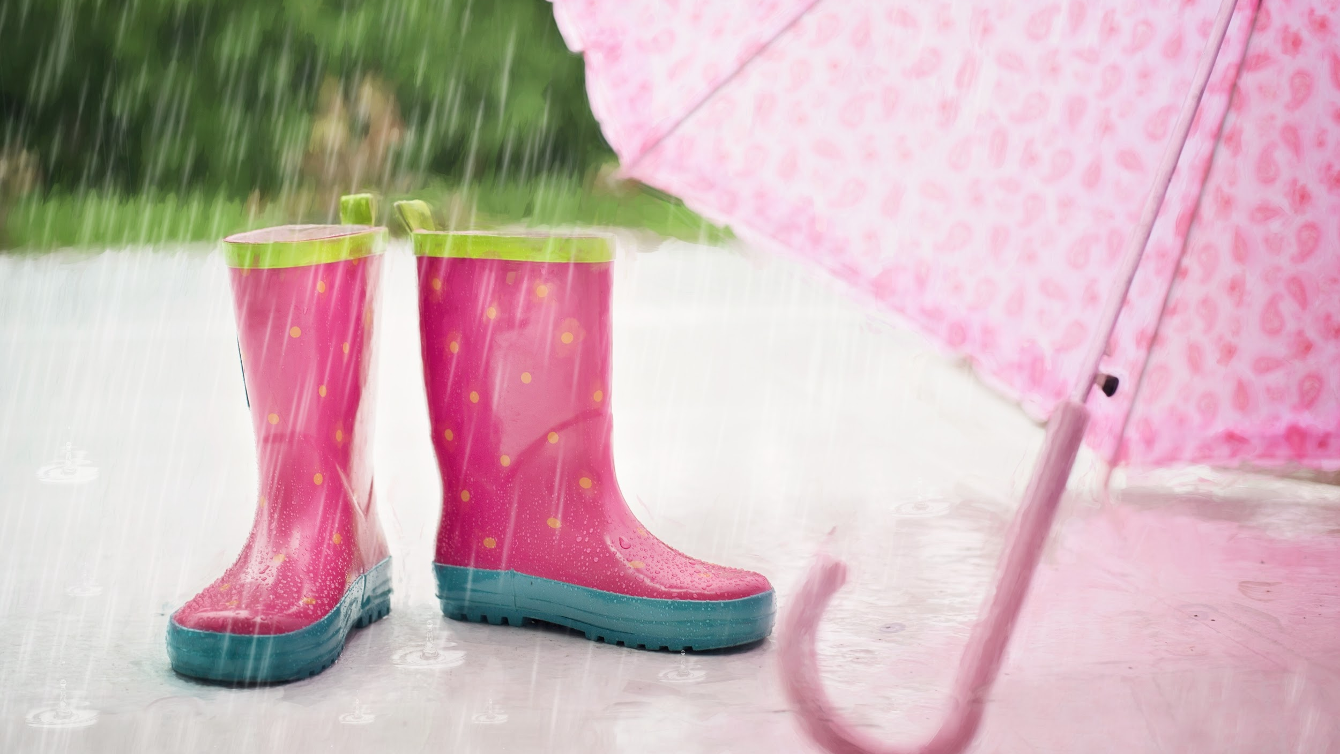

Slide 14
rainboots

