Slide 1


Slide 2
on

Slide 3
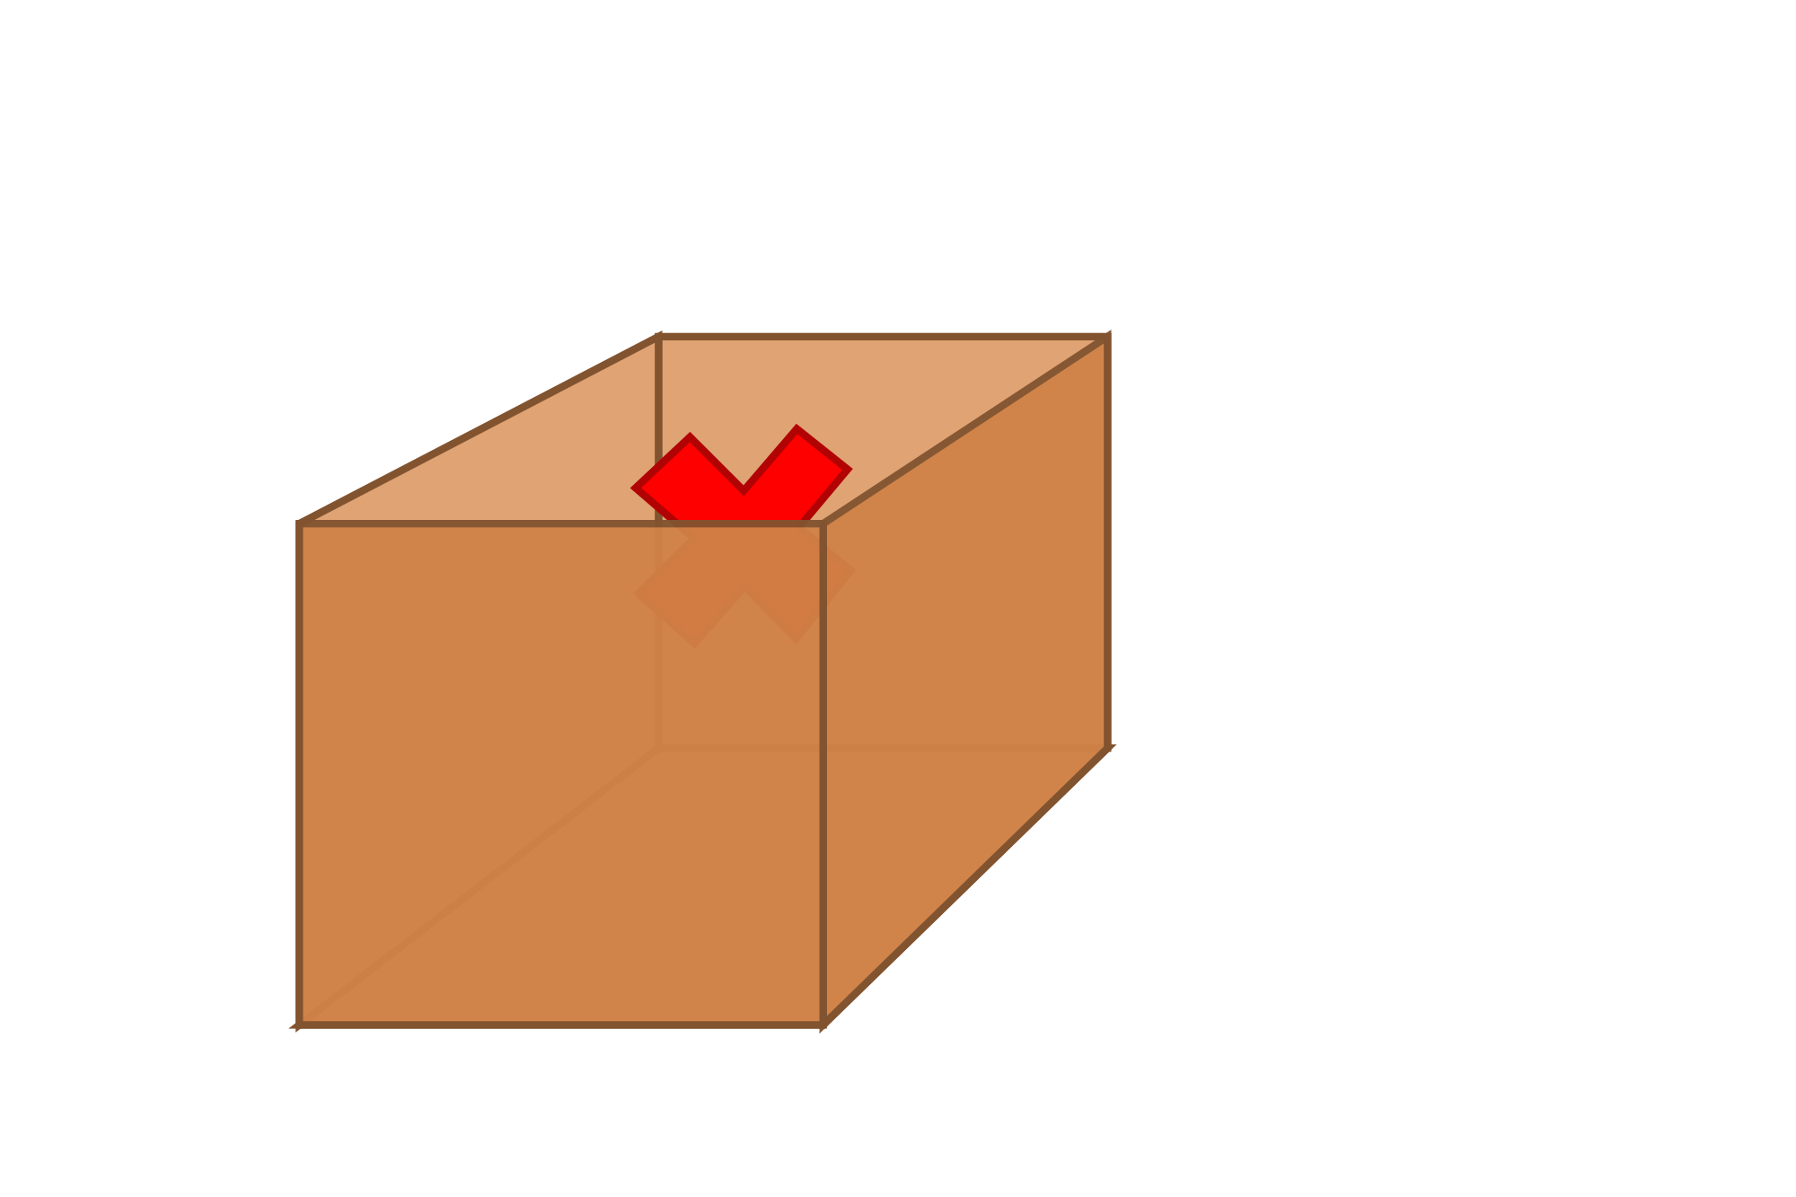

Slide 4
in

Slide 5
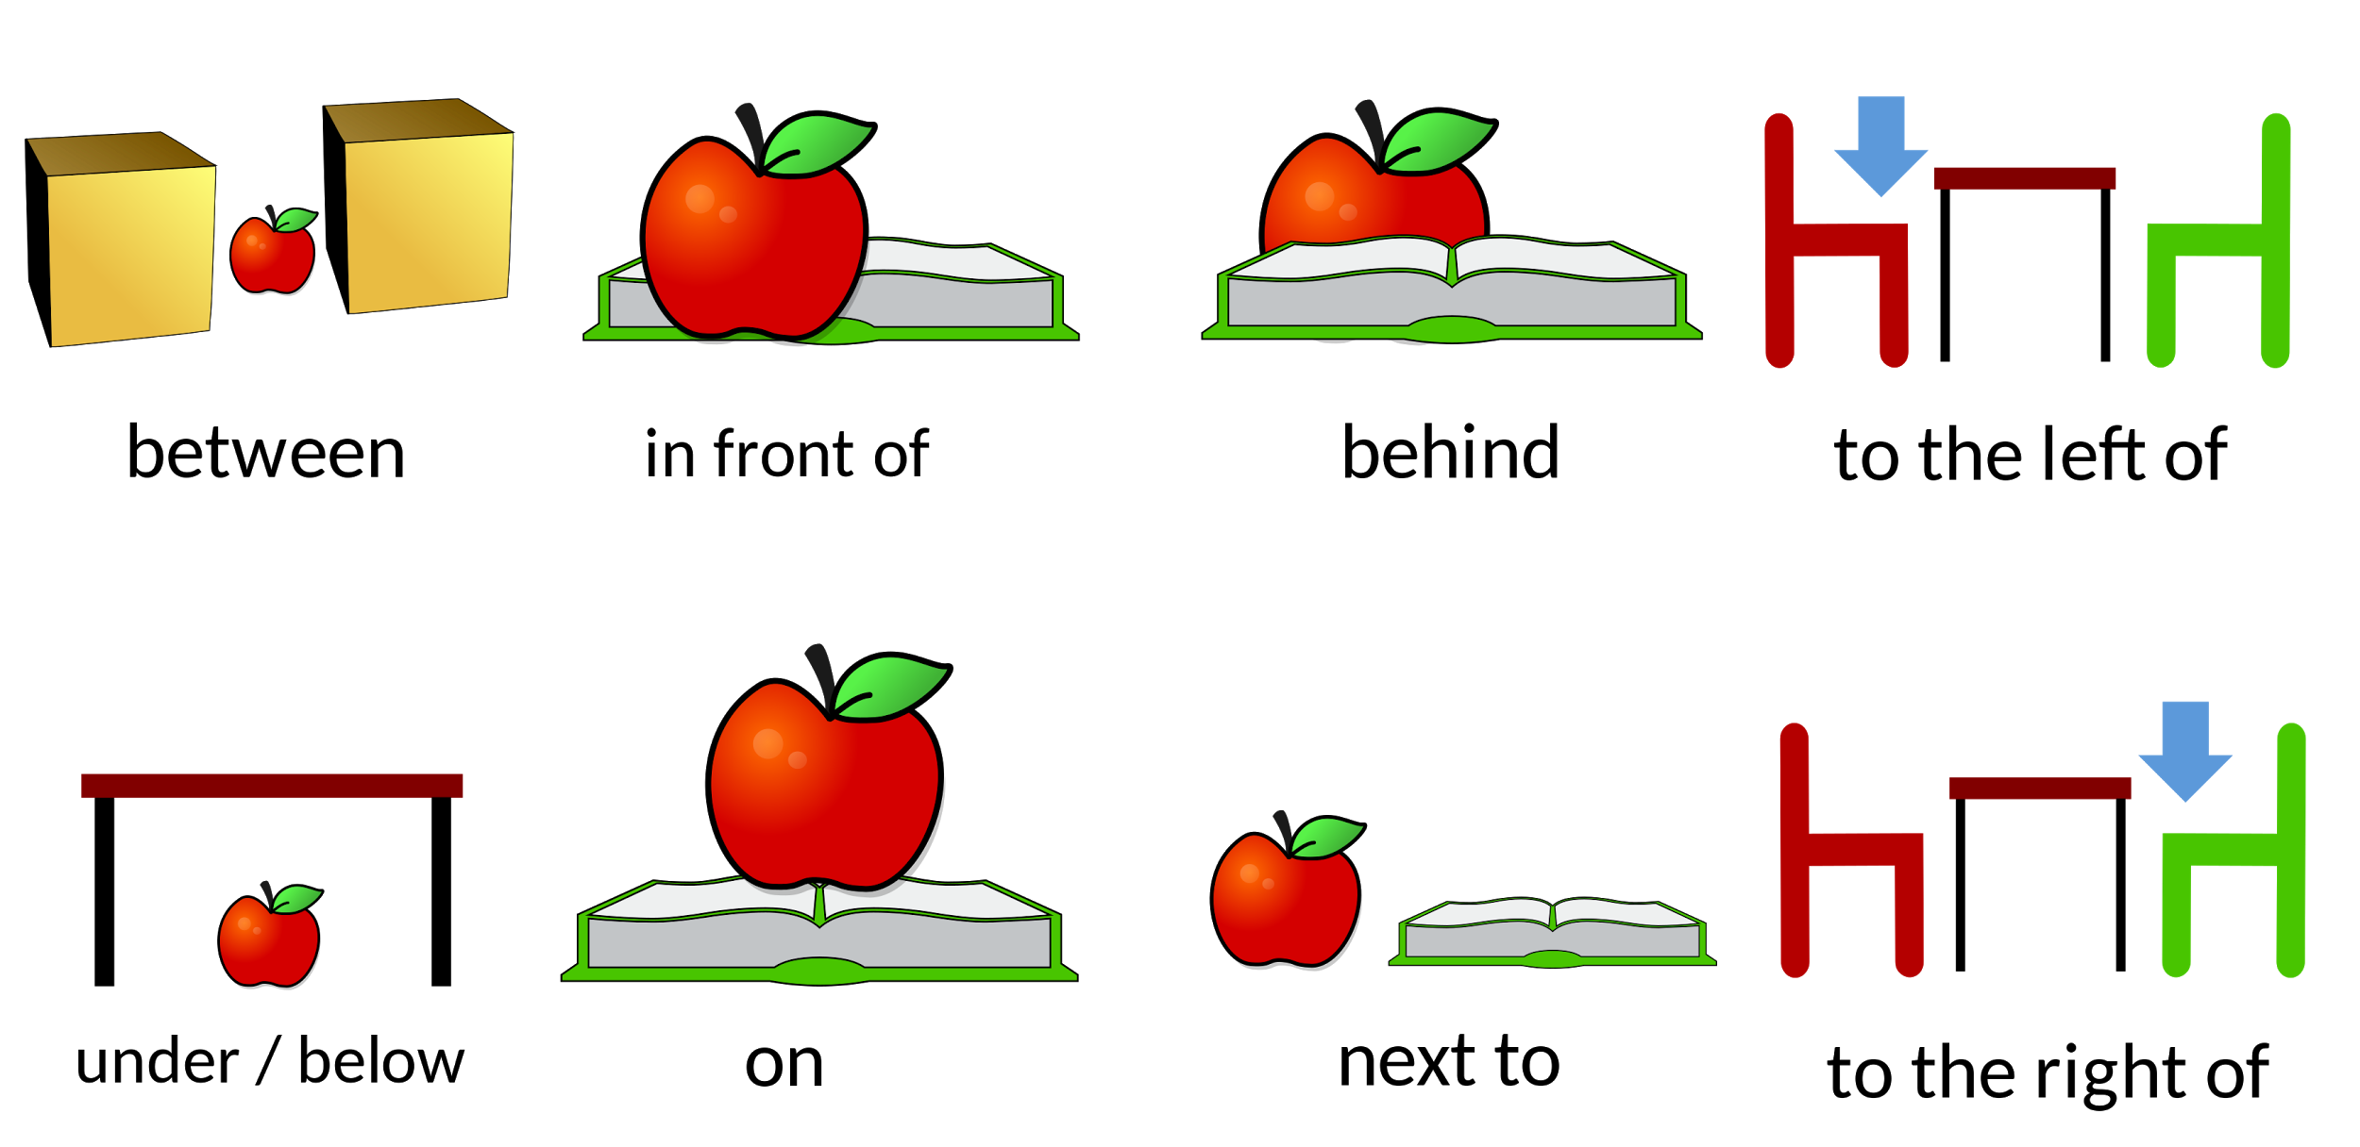

Slide 6
under

Slide 8
around

Slide 9
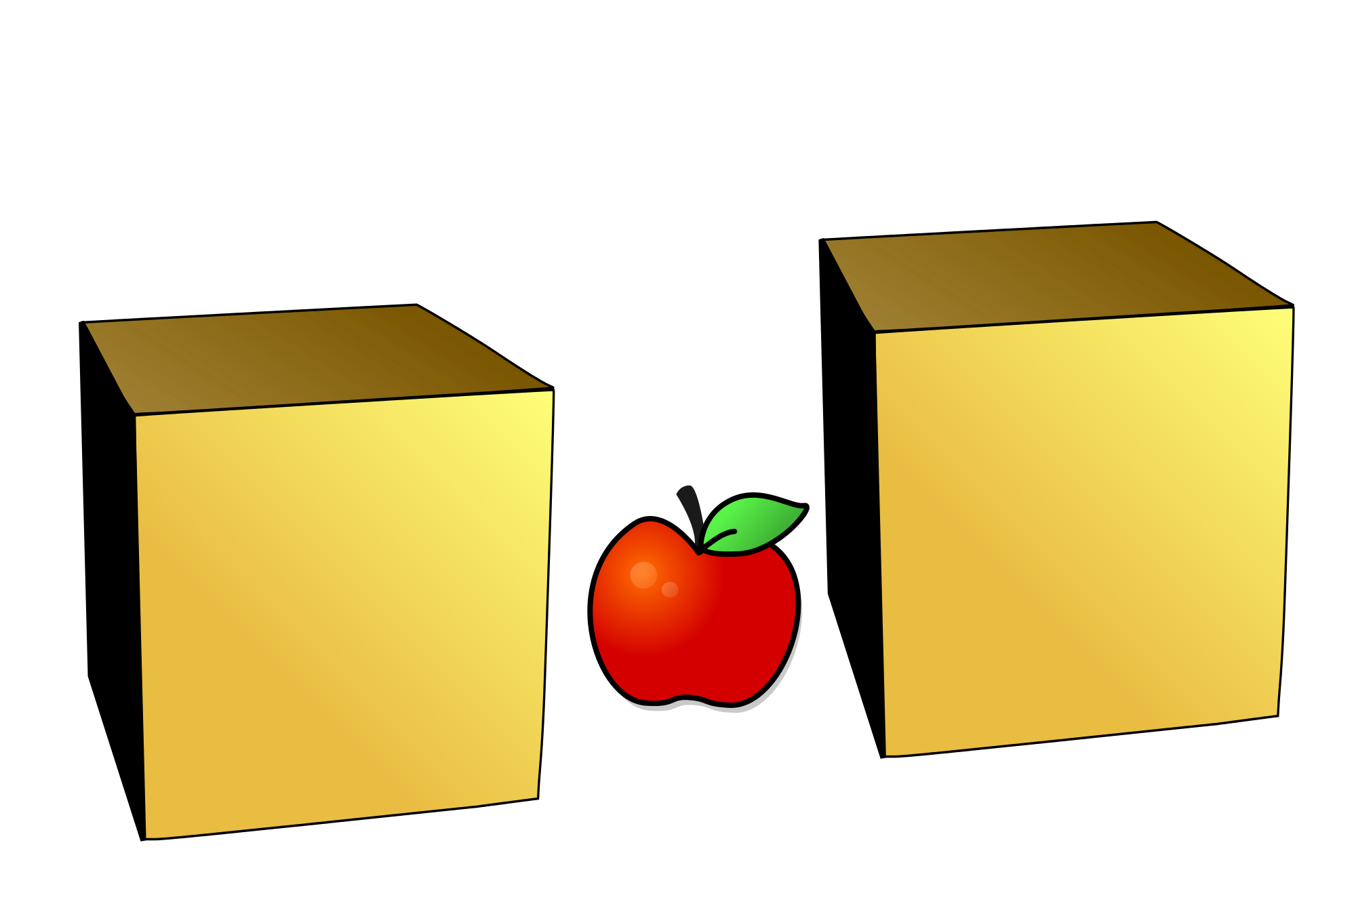

Slide 10
between

