Slide 1
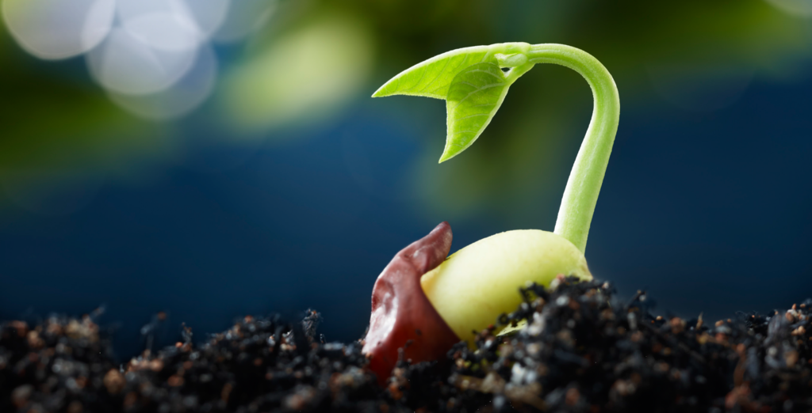

Slide 2
seed

Slide 3
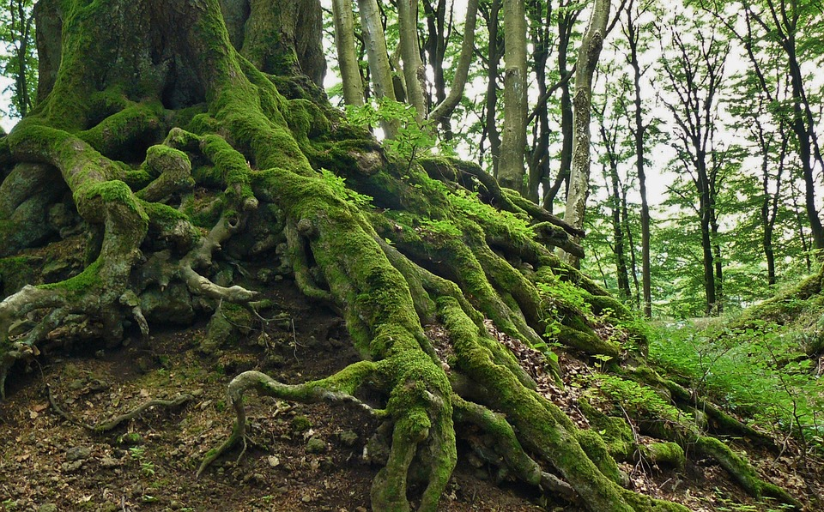

Slide 4
roots

Slide 5
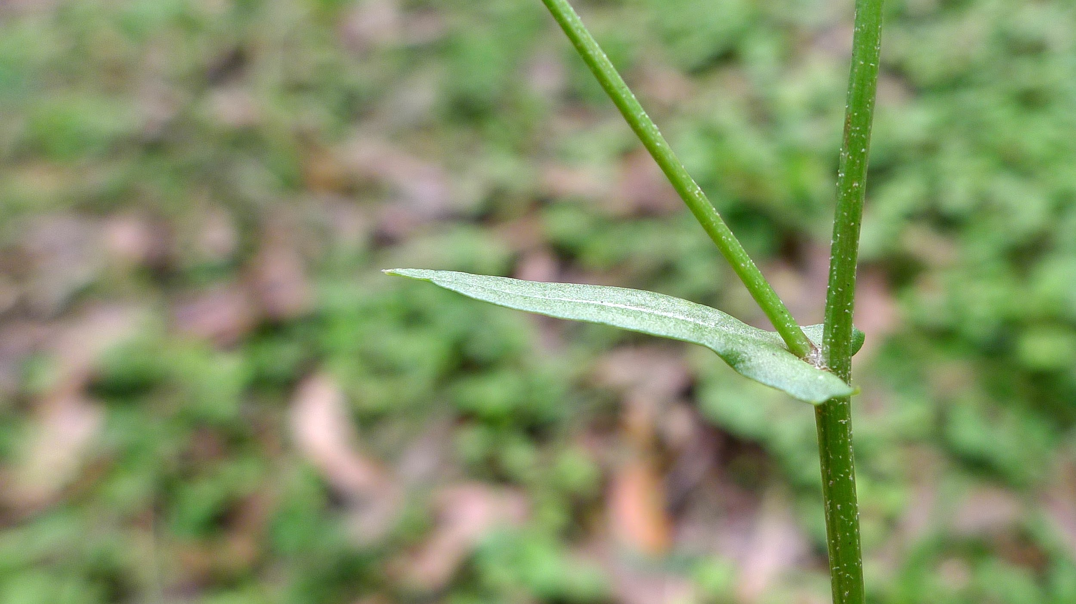

Slide 6
stem

Slide 7
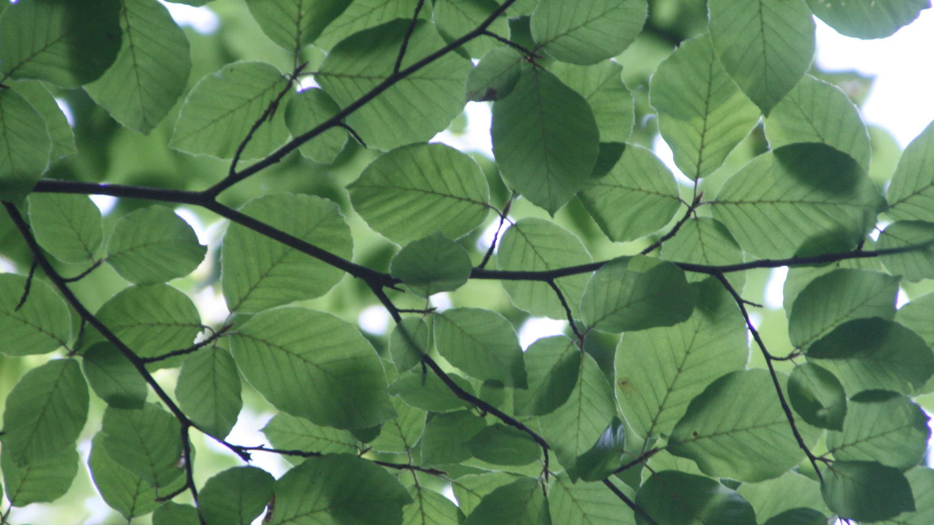

Slide 8
leaves

Slide 9


Slide 10
flower

Slide 11
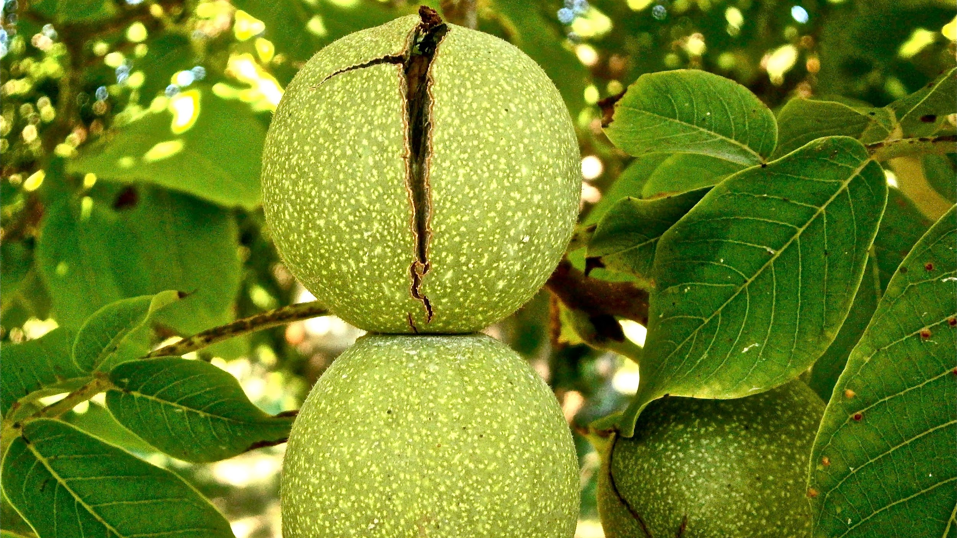

Slide 12
fruit

Slide 13
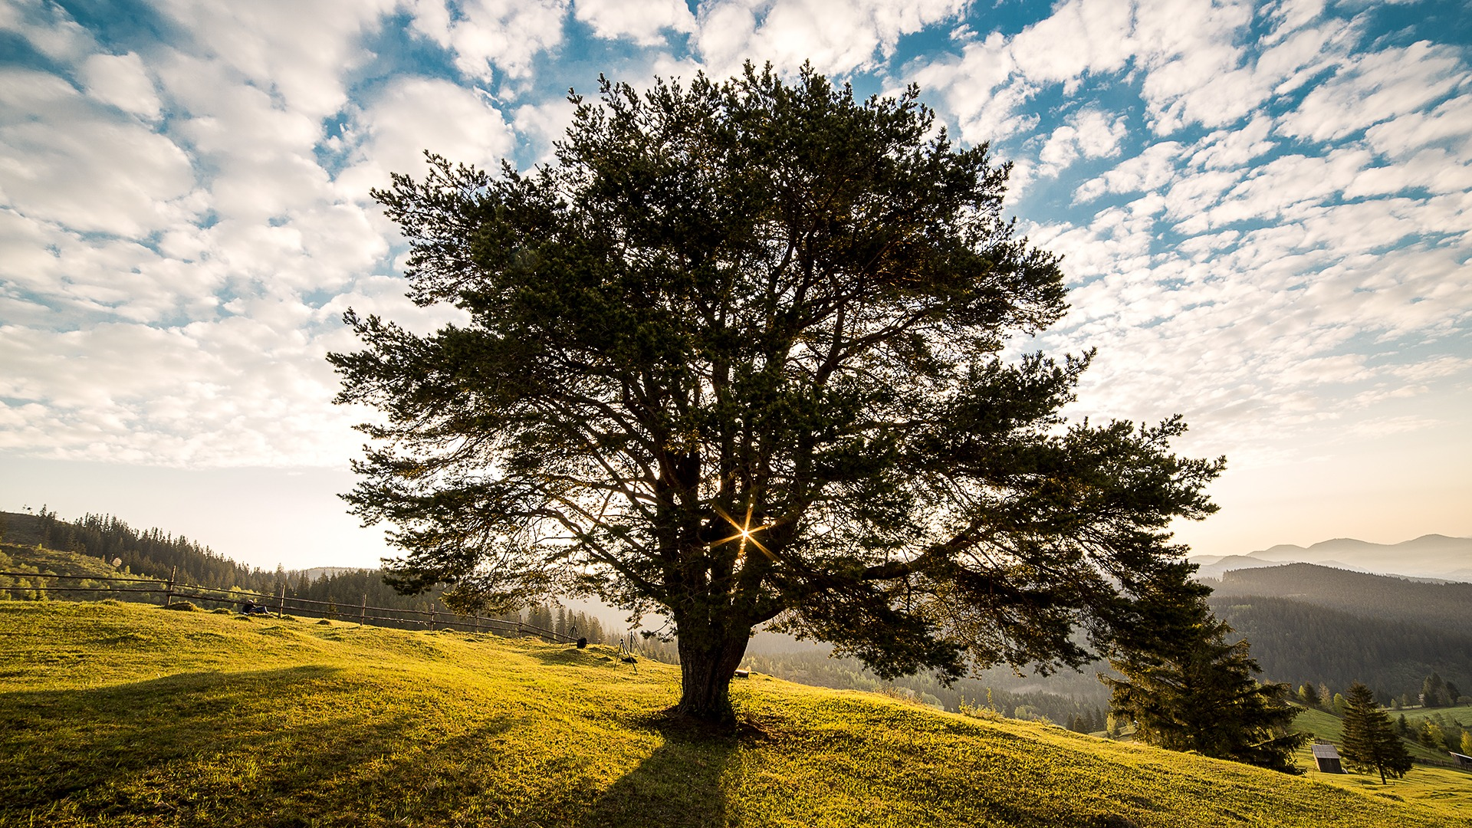

Slide 14
tree

Slide 15
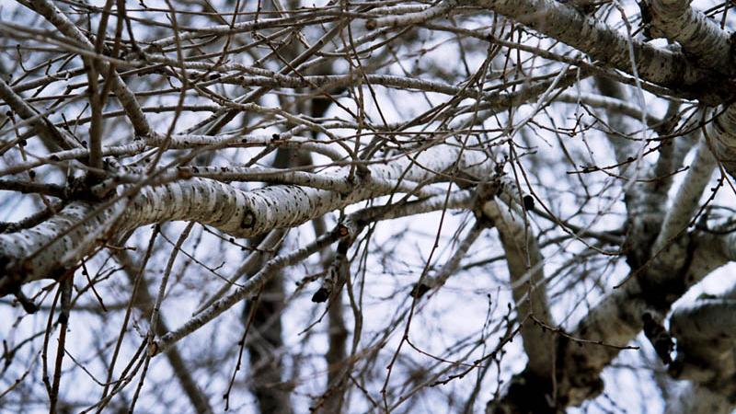

Slide 16
branch

Slide 17
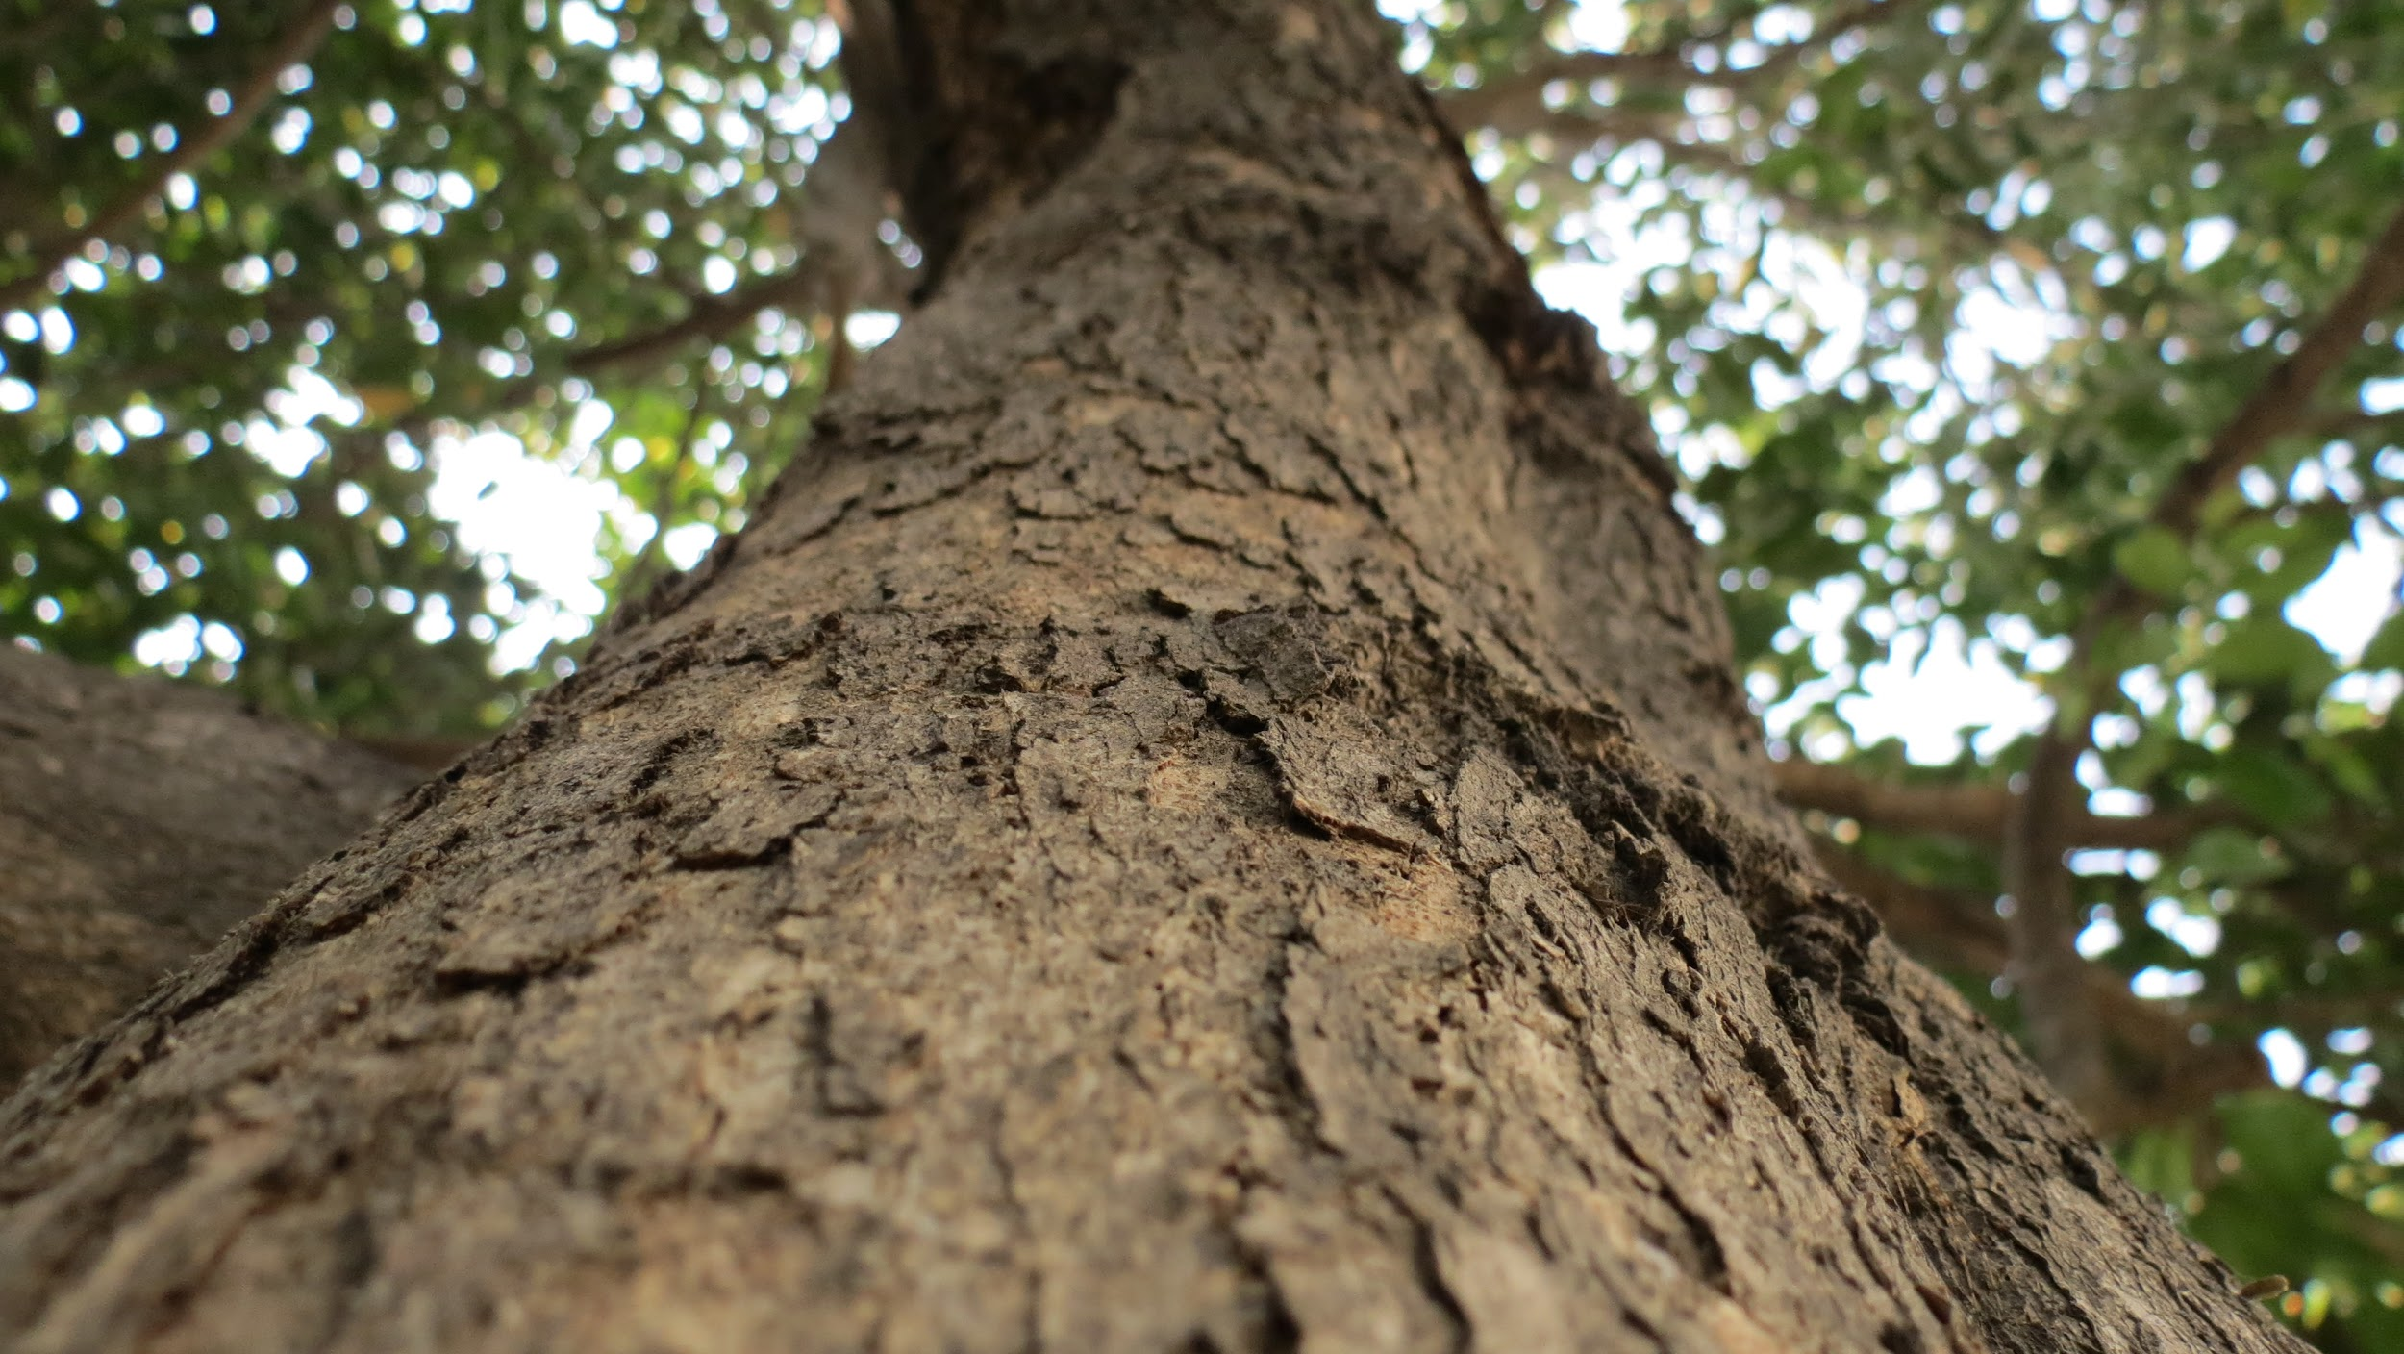

Slide 18
trunk

