Slide 1


Slide 2
worm

Slide 3
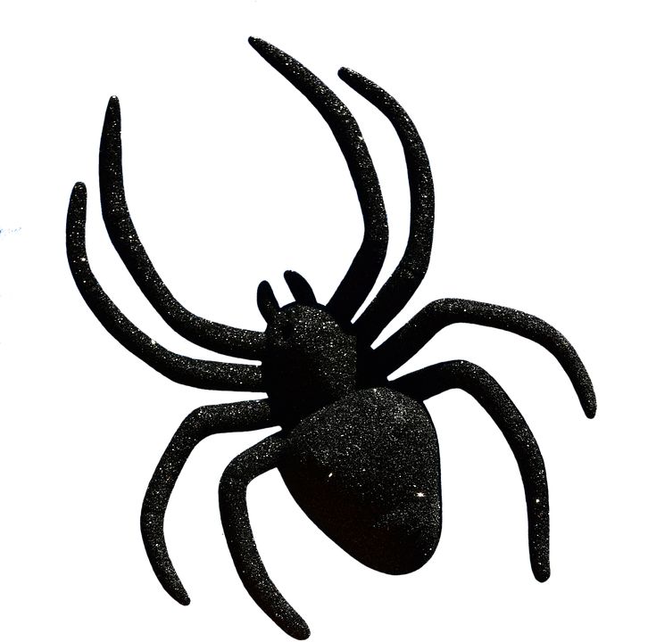

Slide 4
spider

Slide 5
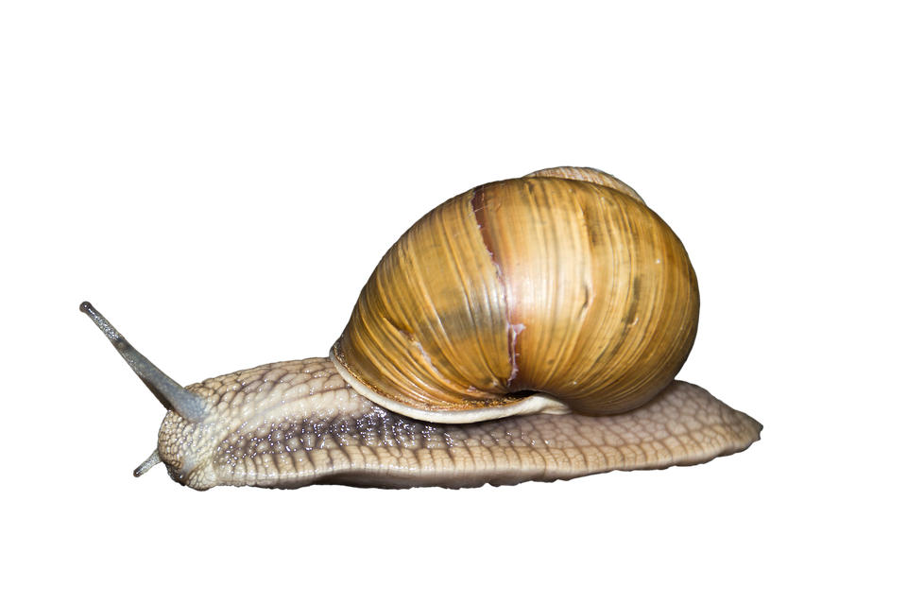

Slide 6
snail

Slide 7
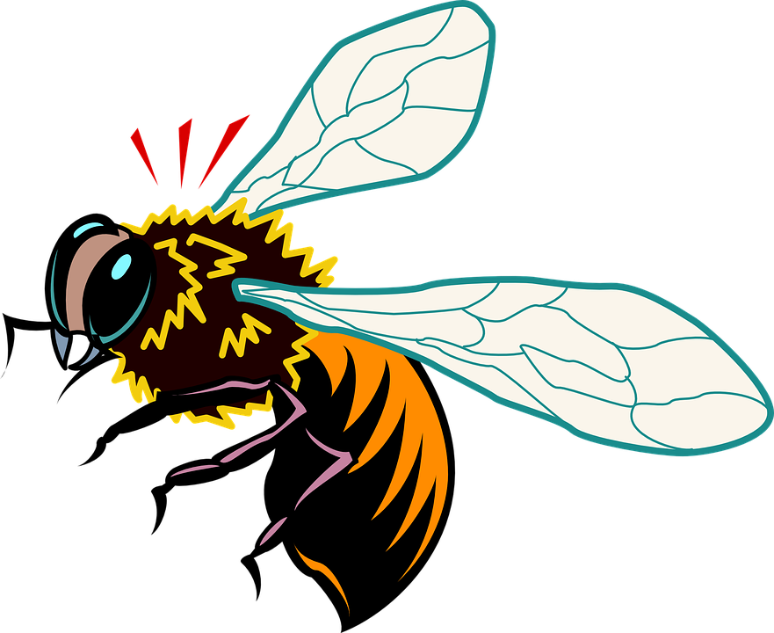

Slide 8
bee

Slide 9


Slide 10
butterfly

